Slide 1
CODEBOOK

Slide 2
Learning Objectives:
What is a codebook and why create one.
Tools available to create a codebook.
Creating the codebook using standard R API functionality.
Manually create a custom codebook.

Slide 3
1. What is a codebook and why create one?
A codebook is a technical description of the data that was collected for a particular purpose.
It describes how the data are arranged in the computer file or files, what the various numbers and letters mean, and any special instructions on how to use the data properly.
A codebook includes metadata for understanding and using a data set.
CodeBook for Course Project of Programming with R
http://rstudio-pubs-static.s3.amazonaws.com/15835_435e9fc505054c7db524e86a6cb51e4a.html

Slide 4
1. What is a codebook and why create one?
Why it is important?
An important document for research or data analysis.
Provides data on variables coding and database generation.
Provide details of the data and where it was sourced.
Provide a reference for the research or analysis many years later.
See: Data Documentation https://coding2share.github.io/ReproducibilityToolkit/Mod4Document.html#codebook
https://uc-r.github.io/data_wrangling/codebook

Slide 5
2 (a) Creating the codebook using standard R API functionality
In R Studio, try this:
Accessing supplied datasets within R Studio
Using the memisc codebook function
Using the summary function
> install.packages("memisc")
> library (memisc)
> x <- data.set(Orange) # cast the data to R dataset
> typeof (x)
[1] "list"
> x
Tree age circumference
1 1 118 30
2 1 484 58
3 1 664 87
4 1 1004 115
1 1231 120
> codebook (x) #call the codebook function
> summary (x)
List the datasets available in R, type:
> data ()

Slide 6
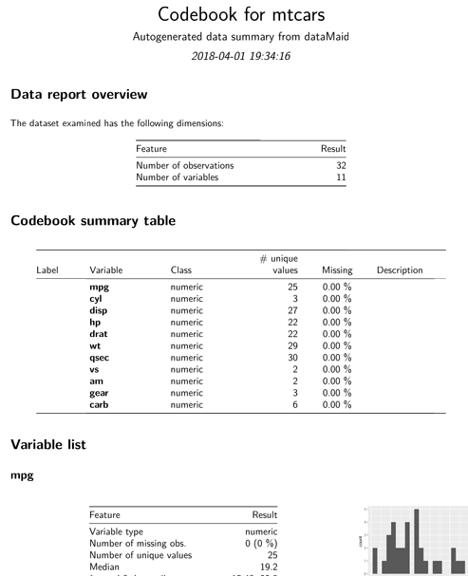
2 (b) Code to automatically generate a codebook - Using dataMaid Package
install.packages("dataMaid")
library(dataMaid)
data(mtcars)
makeCodebook(mtcars)

Slide 7
2 (c) Manually create a custom codebook.
Using the class function to determine the data type.
Using the sapply function to extract more details.
Using the Orange dataset supplied with R studio.
Try the following:
> x <- data.set(Orange)
> class (Orange)
[1] "nfnGroupedData" "nfGroupedData" "groupedData" "data.frame"
> sapply(Orange,class)
$Tree
[1] "ordered" "factor"
$age
[1] "numeric"
$circumference
[1] "numeric"

Slide 8
sapply ()
> sapply (Orange, min)
Tree age circumference
1 118 30
> sapply (Orange, max)
Tree age circumference
5 1582 214
> sapply (Orange, range)
Tree age circumference
[1,] 1 118 30
[2,] 5 1582 214
> summary (Orange)
Tree age circumference
3:7 Min. : 118.0 Min. : 30.0
1:7 1st Qu.: 484.0 1st Qu.: 65.5
5:7 Median :1004.0 Median :115.0
2:7 Mean : 922.1 Mean :115.9
4:7 3rd Qu.:1372.0 3rd Qu.:161.5
Max. :1582.0 Max. :214.0

Slide 9
Create your codebook
Now based on what you have learnt in this tutorial.
Choose any dataset available in R Studio and create a codebook using the 3 methods presented in this tutorial.
Briefly, explain what is presented.
Submit on Spectrum before you leave the tutorial session.

